Slide 1







Precise timing of solar flare footpoint sources from mid-infrared observations
Simões, Fletcher, Hudson, Kerr, Penn, Lopez. MNRAS 532, 2024. arxiv 2406.11361
Paulo Simões
Centro de Rádio Astronomia e Astrofísica Mackenzie - CRAAM
Escola de Engenharia, Universidade Presbiteriana Mackenzie
paulo@craam.mackenzie.br
PRESTO/SCOSTEP Workshop 18th-22nd October 2024 São Paulo, SP

Slide 2
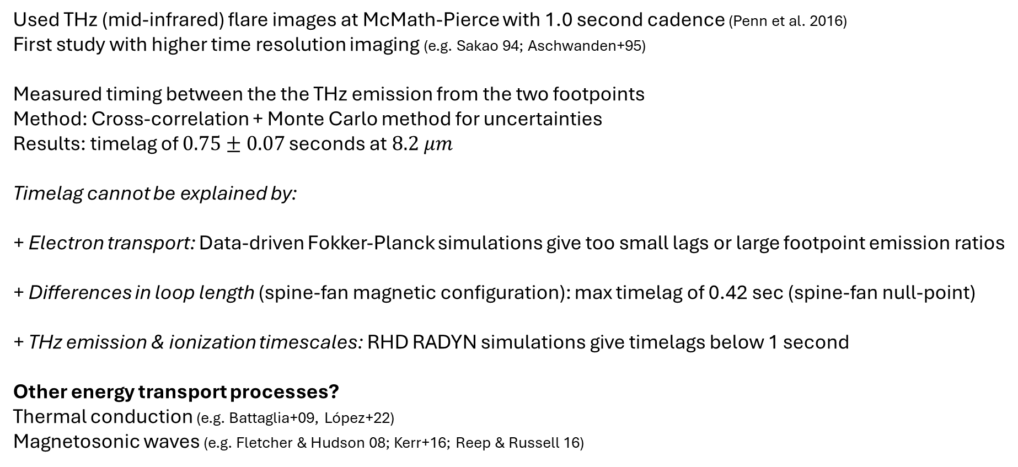
Too long; didn't read
Used THz (mid-infrared) flare images at McMath-Pierce with 1.0 second cadence (Penn et al. 2016)
First study with higher time resolution imaging (e.g. Sakao 94; Aschwanden+95)
Measured timing between the the THz emission from the two footpoints
Method: Cross-correlation + Monte Carlo method for uncertainties
Results: timelag of $0.75±0.07$ seconds at$8.2 μm$
Timelag cannot be explained by:
+ Electron transport: Data-driven Fokker-Planck simulations give too small lags or large footpoint emission ratios
+ Differences in loop length (spine-fan magnetic configuration): max timelag of 0.42 sec (spine-fan null-point)
+ THz emission & ionization timescales: RHD RADYN simulations give timelags below 1 second
Other energy transport processes?
Thermal conduction (e.g. Battaglia+09, López+22)
Magnetosonic waves (e.g. Fletcher & Hudson 08; Kerr+16; Reep & Russell 16)

Slide 3
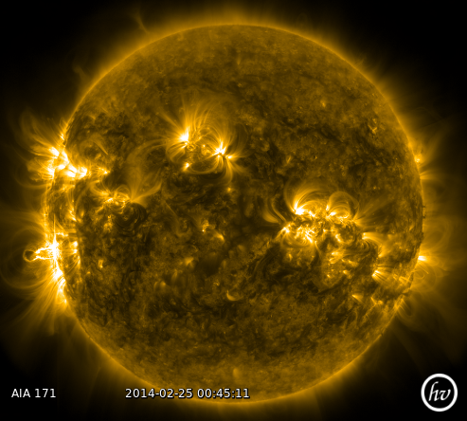
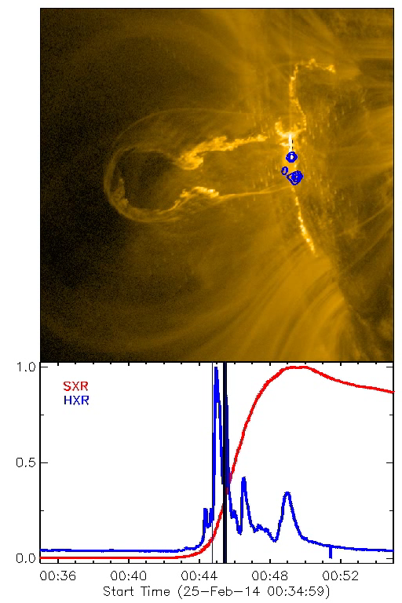
Solar flares

Slide 4
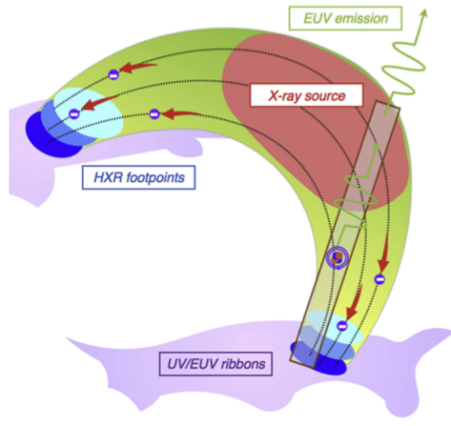
Solar flares: a general view
1. Magnetic reconnection
Eruption
CME
2. Energy release
heating, acceleration
3a. Eruption & CME
3b. Re-organization
of surrounding magnetic field
reconnection
3c. Particle transport
Electrons (HXR, MW)
Ions (gamma-rays)
4. Energy deposition +
chromospheric response
4a. Heating, ionisation, emission
4b. Plasma flows
Chromospheric “condensation”
4c. Chromospheric “evaporation”
Hot coronal plasma (EUV, SXR)
upflows
corona
heating
5. Gradual phase: cooling
Adapted from Jeffrey et al. 2017
chromosphere
downflows
photosphere

Slide 5
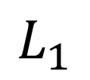
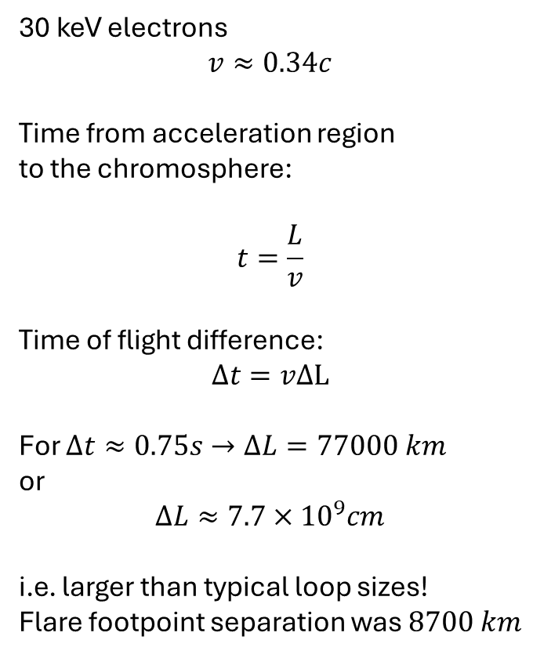
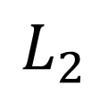
Timing footpoint emission as a test for energy transport by electrons
30 keV electrons
$$v≈0.34c$$
Time from acceleration region to the chromosphere:
$$t=\frac{L}{v}$$
Time of flight difference:
$$Δt=vΔL$$
For $Δt≈0.75s→ΔL=77000 km$
or
$$ΔL≈7.7×{10}^{9}cm$$
i.e. larger than typical loop sizes!
Flare footpoint separation was $8700 km$
$$L_{1}$$
$$L_{2}$$
See e.g. Aschwanden+95; Fletcher 09

Slide 6

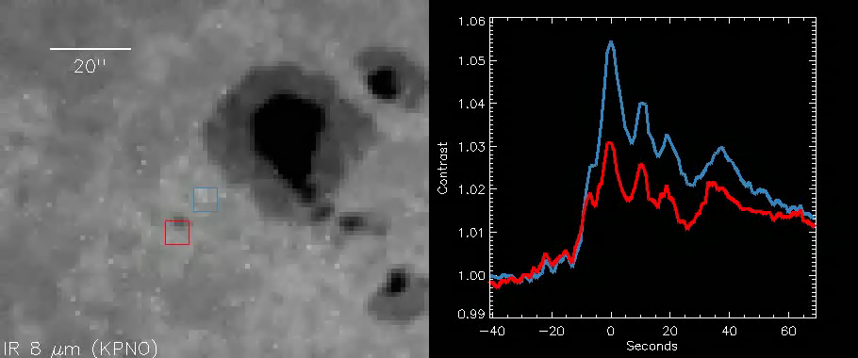
Solar Flares in the THz (mid-infrared)
THz flares: Kaufmann+13; Trottet+15, Penn+16, Giménez de Castro+18; F. López+22; K. Lopez+ (in prep.)
Penn et al. 2016
SOL2014-09-24 GOES C class
McMath-Pierce Telescope at Kitt Peak

Slide 7
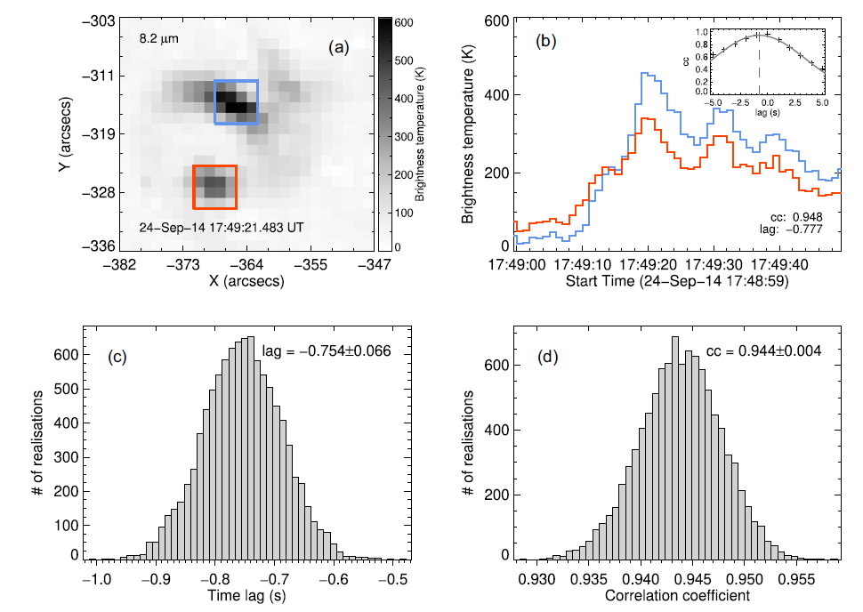
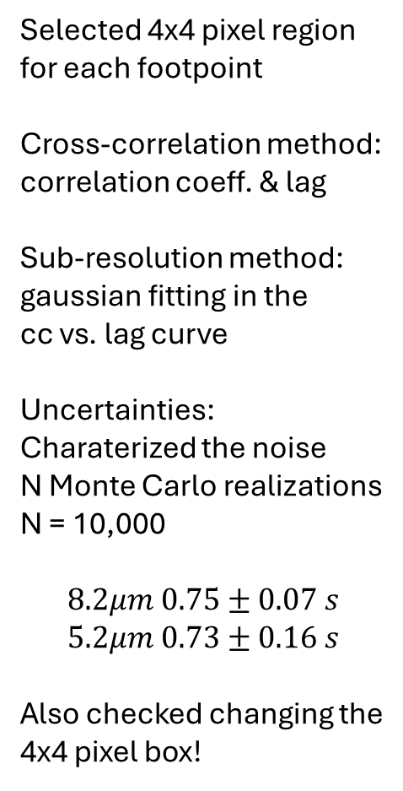
Measuring Timelags
Selected 4x4 pixel region
for each footpoint
Cross-correlation method: correlation coeff. & lag
Sub-resolution method:
gaussian fitting in the cc vs. lag curve
Uncertainties:
Charaterized the noise
N Monte Carlo realizations
N = 10,000
$$8.2μm 0.75±0.07 s \\ 5.2μm 0.73±0.16 s$$
Also checked changing the 4x4 pixel box!

Slide 8
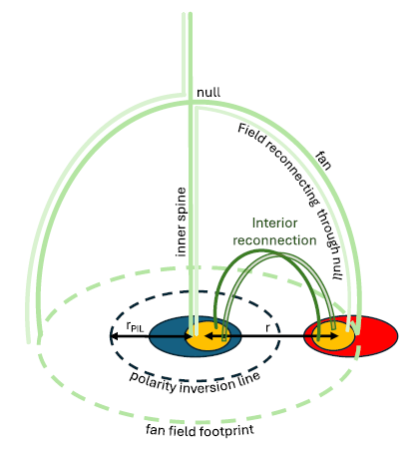
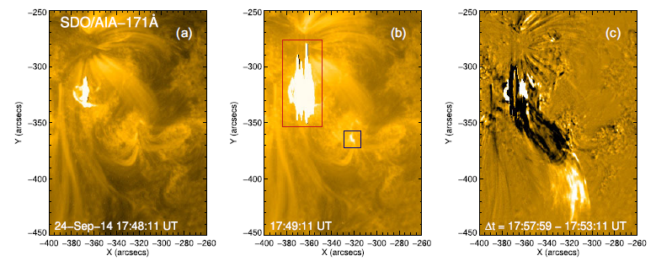
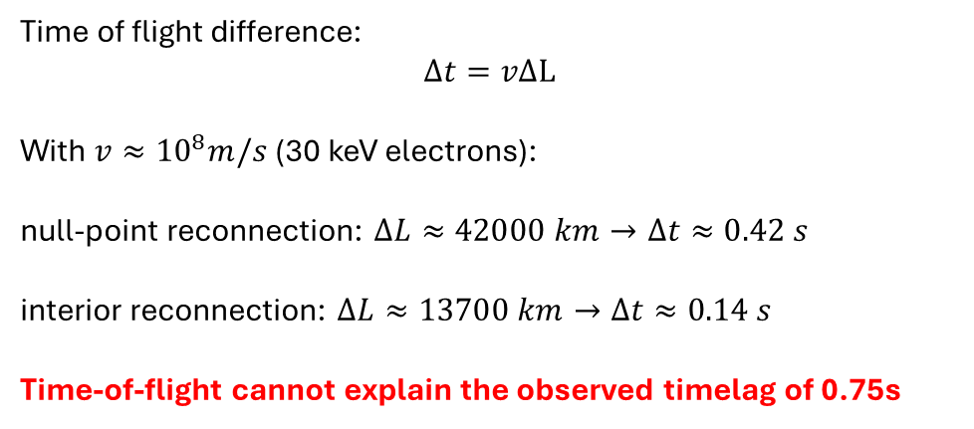
Testing time-of-flight: magnetic field geometry
Spine-fan magnetic configuration
flare footpoints
Time of flight difference:
$$Δt=vΔL$$
With $v≈{10}^{8}m/s$ (30 keV electrons):
null-point reconnection: $ΔL≈42000 km→Δt≈0.42 s$
interior reconnection: $ΔL≈13700 km→Δt≈0.14 s$
Time-of-flight cannot explain the observed timelag of 0.75s

Slide 9
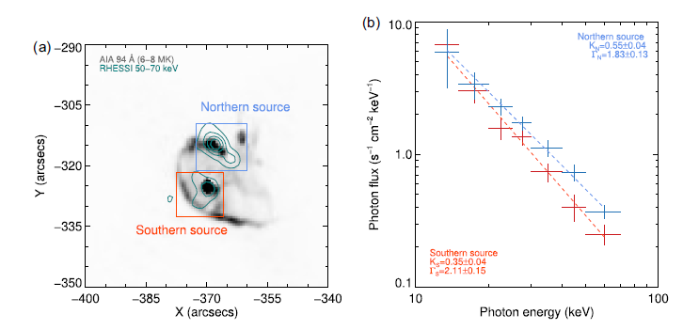
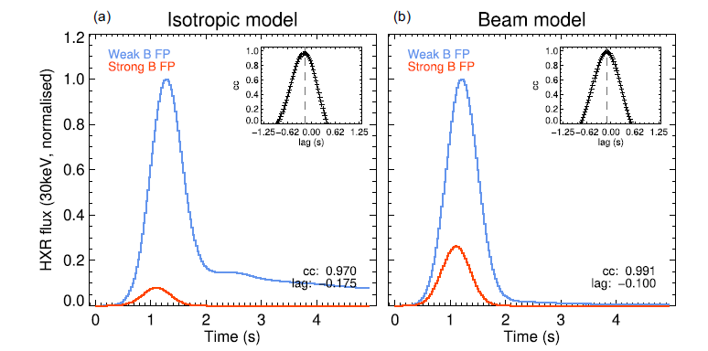
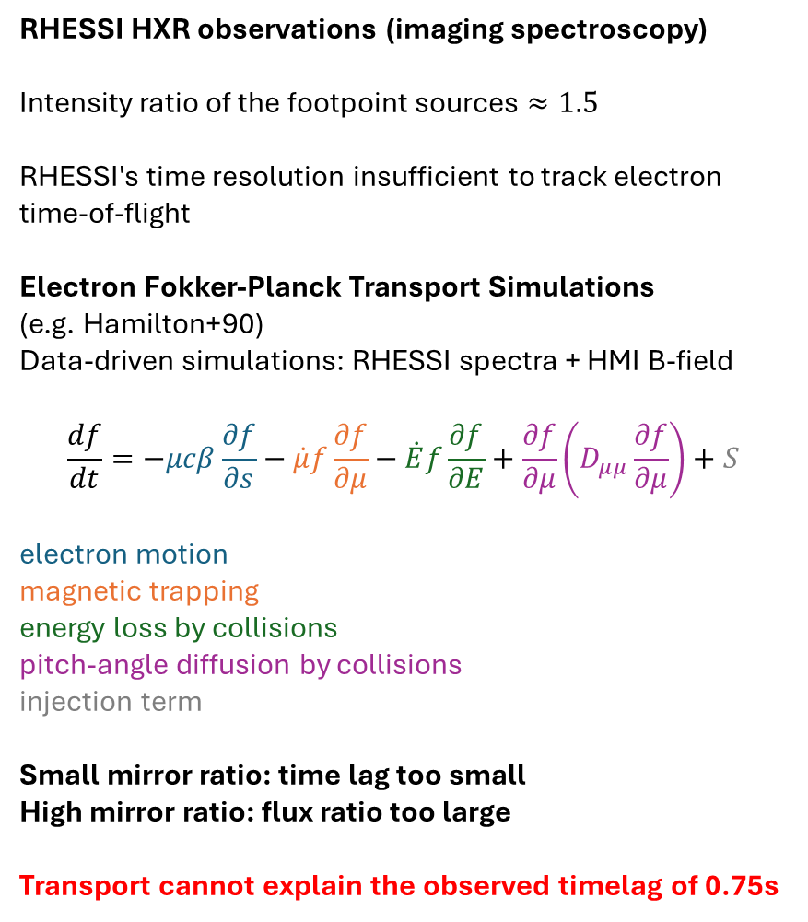
Testing Electron Transport
RHESSI HXR observations (imaging spectroscopy)
Intensity ratio of the footpoint sources $≈1.5$
RHESSI's time resolution insufficient to track electron time-of-flight
Electron Fokker-Planck Transport Simulations
(e.g. Hamilton+90) Data-driven simulations: RHESSI spectra + HMI B-field
$$\frac{df}{dt}=−μcβ\frac{∂f}{∂s}−\dot{μ}f\frac{∂f}{∂μ}−\dot{E}f\frac{∂f}{∂E}+\frac{∂f}{∂μ}\left(D_{μμ}\frac{∂f}{∂μ}\right)+S$$
electron motion
magnetic trapping
energy loss by collisions
pitch-angle diffusion by collisions
injection term
Small mirror ratio: time lag too small
High mirror ratio: flux ratio too large
Transport cannot explain the observed timelag of 0.75s

Slide 10
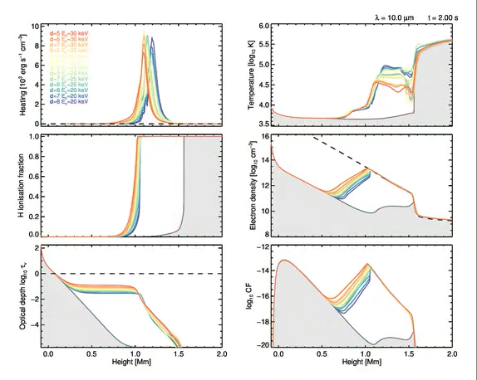
Flare Simulations: RADYN code
Simões et al. 2017 A&A 605
Energy Input
Temperature
Radiative hydrodynamic simulations: RADYN (Allred et al. 2015): 1D atmosphere; hydrodynamics, non-LTE atomic populations and radiative transfer, back-warming: in response to energy input
Quiet Sun: Photospheric H- opacity
Flare: Chromospheric H free-free
Optically thin
Ionisation of H supplies free electrons
No enhancement from the photosphere!
Model results in agreement with data (Penn et al. 2016)
Electron
density
H ionisation
Contribution
function
Optical depth
Also: Heinzel & Avrett 2012 Sol. Phys. 277

Slide 11
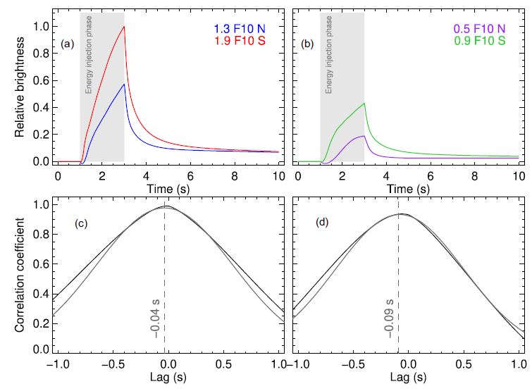
Testing THz timescales
RADYN + IR/THz emission
(Simões+17)
Data-driven simulations:
electron energy distribution taken from RHESSI data analysis
Response time of the H ionization in the chromosphere is *fast*
Non-thermal ionization (Fang+93)
dominates over termal ionization
Recombination rates are high: H neutralizes without energy input
IR/THz is very impulsive!
Timescales to produce THz emission cannot explain the observed timelag of 0.75s

Slide 12
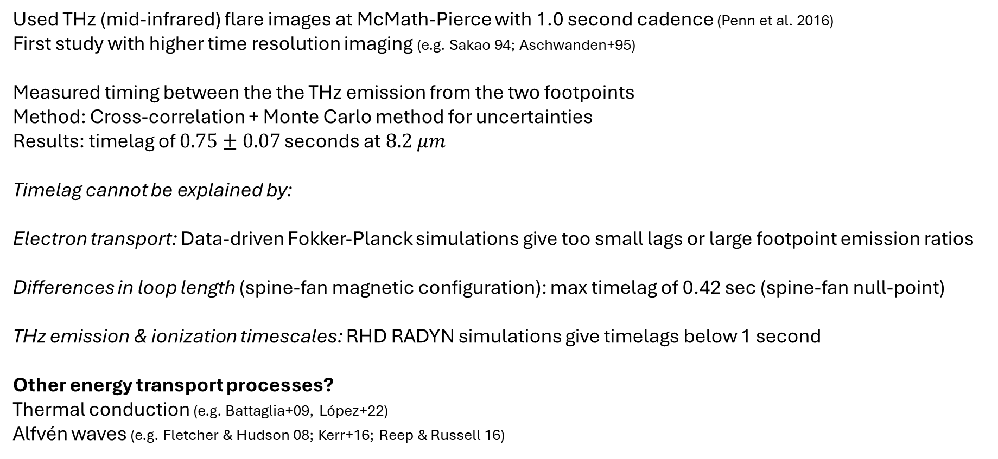
Summary
Used THz (mid-infrared) flare images at McMath-Pierce with 1.0 second cadence (Penn et al. 2016)
First study with higher time resolution imaging (e.g. Sakao 94; Aschwanden+95)
Measured timing between the the THz emission from the two footpoints
Method: Cross-correlation + Monte Carlo method for uncertainties
Results: timelag of $0.75±0.07$ seconds at$8.2 μm$
Timelag cannot be explained by:
Electron transport: Data-driven Fokker-Planck simulations give too small lags or large footpoint emission ratios
Differences in loop length (spine-fan magnetic configuration): max timelag of 0.42 sec (spine-fan null-point)
THz emission & ionization timescales: RHD RADYN simulations give timelags below 1 second
Other energy transport processes?
Thermal conduction (e.g. Battaglia+09, López+22)
Alfvén waves (e.g. Fletcher & Hudson 08; Kerr+16; Reep & Russell 16)
arxiv 2406.11361
paulo@craam.mackenzie.br

